Slide 1


SMART ESSAY GRADER
Dhruv Sharma
Ayush Shukla
Hitesh Verma

Slide 3
‘Grading essays by computer? For many of us, the idea at first seems utter nonsense, to be rejected out of hand. The fastest rejection came from an English professor at a certain well‐known New England institution. He heard the idea, digested it thoroughly, and pronounced an indignant “Impossible!”, all within ten seconds. With further conversation, I learned that this professor knew almost nothing of the various disciplines, even linguistics, which must participate in grading by computer… [But] upon closer inspection, and with more background knowledge, the notion takes on a certain fascinating inevitability: we will soon be grading essays by computer, and this development will have astonishing impact on the educational world
- ANONYMOUS
Notes:
Yes !! For many of us, the idea at first seems utter nonsense, to be rejected out of hand: But, Using NLP , our system predict scores and provide feedback for the essays written by students

Slide 4
Problem Description
The problem of automated essay scoring is a long standing goal in the world of natural language processing.
It is a well explored problem with potential applications for standard educational testing companies like ETS
Major applications includes University application grading for SOP, School grading , GRE, TOEFL , IELTS etc.
The task of providing fine-grained feedback for essay has not been explored much.
A system that gives relevant feedback to different parts of the essay will help students to improve their writing and prepare better for these tests.
Notes:
The task of providing fine-grained feedback for essay has not been explored much.

Slide 5
Related Work
Liu et al. used Support Vector Machine (SVM) and logistic regression to develop a system to assign scores to features like ‘spelling’ and ‘supporting ideas’.
Zilly et al.(2017) use the idea of using reccurent highway networks to infuse it into the classic vanilla RNN architecture
Alikaniotis et al. have shown that effective essay scoring can be accomplished using multilayer bidirectional LSTM.
Notes:
SVM + logistic regression , highway networks + rnn archtecture, multilayer bidirectional LSTM

Slide 6
ASAP DATASET
ASAP – AUTOMATED STUDENT ASSESMENT PRIZE
13,000 graded student essays written by 7th-10th grade students across 8 different prompt provided by Hewlett Foundation on Kaggle
Essay are between 150 -550 words.
Notes:
Score scaling?

Slide 7
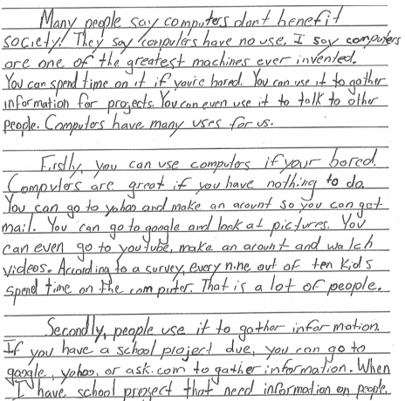
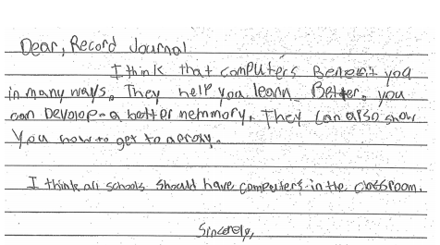
Bad Essay
Good Essay
Notes:
As you can see essay having small content, poorly articulated or having more spelling mistakes -> lower score .

Slide 8
Implementation flow
Data Processing
Preprocessed the essays
Normalized all essay scores between 0 and 1
Process Essay chunks dataset
Training Glove vectors from our corpus
Creating multidimensional structure of essay dataset by dividing the essays into chunks
Created associated word embedding
Training
Training the dataset using LSTM and Feed forward Neural Networks pipeline model
Evaluation
Evaluated the performance of this model using Root Mean squared Error (RMSE)

Slide 9

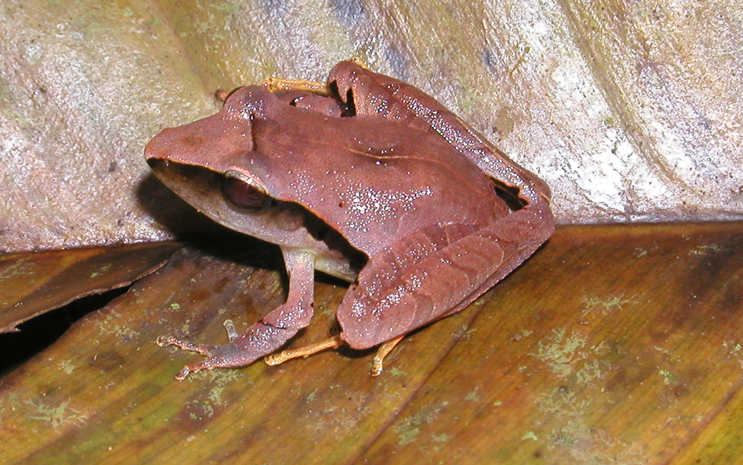
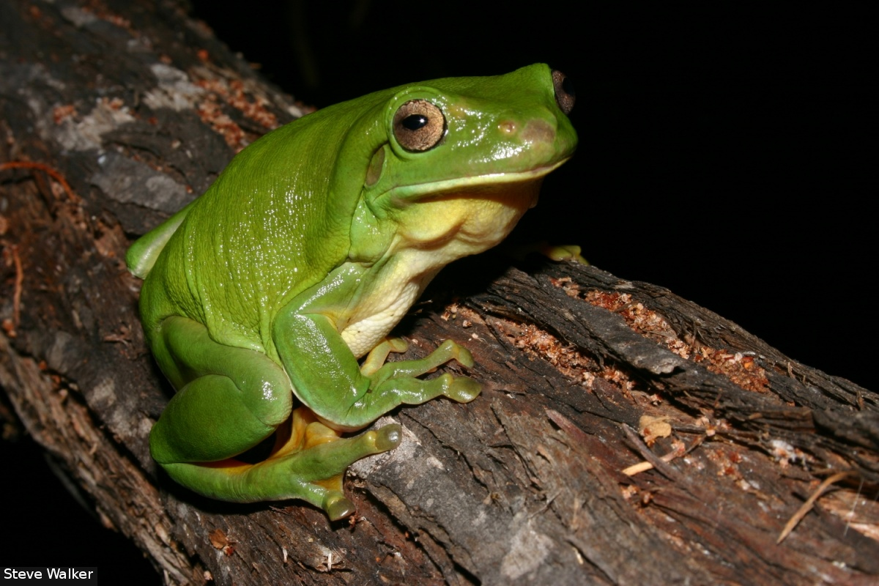
GloVe: Global Vectors for word representation
GloVe is an unsupervised learning algorithm for obtaining vector representations for words.
The nearest neighbors of the word ‘frog’ using GloVe: Frogs, Toad, litoria, leptodactylidae, rana, eleutherodactylus.
Notes:
We trained the glove word vectors on our corpus.? Why we used ???? Dhruv notes

Slide 10
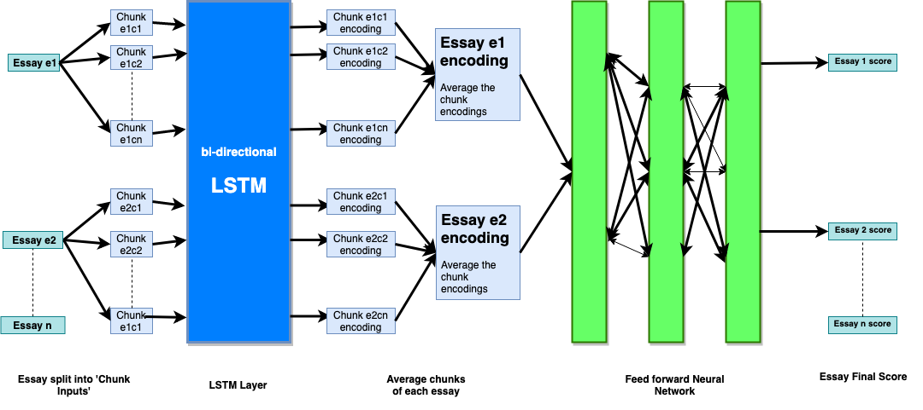
Our model
Notes:
Higher overview of our pipeline model:

Slide 11
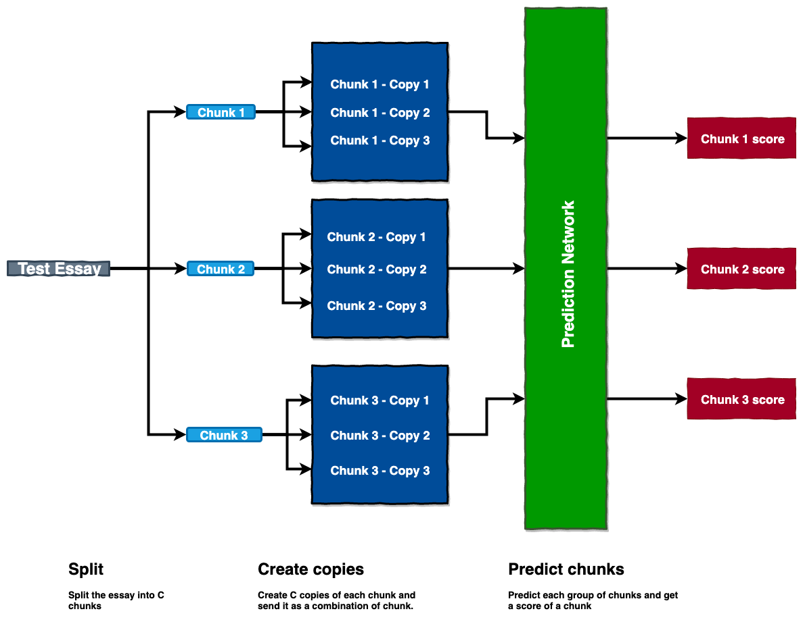
Chunk Prediction
Notes:
Why we are doing chunking?

Slide 12
Threshold
We needed to set a threshold to decide the weaker parts of the chunk. If the chunk score is below the difference between essay score and threshold, we decide that the chunk is a poor part of the essay.
We set the threshold according to our RMSE. Since our RMSE was about 0.16, so we set the threshold above the RMSE and set it to 0.30 as our threshold.

Slide 13
Results : RMSE
Word embedding | LSTM | GRU | RNN | Single Layer LSTM
Glove vectors | 0.1639 | 0.17119 | 0.1839 | 0.1712
Google Word2vec | 0.1692 | 0.17851 | 0.1851 | 0.1756
Notes:
GRU ? Gated reccurent unit

Slide 14
Good Essay
"The mood created by person, the author of the memoir, Home: The Blueprints of Our Lives, is a comforting one. This is shown, for instance, by his reccolection of his childhood in his family's home being fond. For example, he states that he is ""eternally grateful"" for his parents passing on, ""their rich culinary skills and love of cooking"" that he claims to still have. Also, he remembers life as being neighborly and treating neighbors and friends as part of their family with kindness and sharing. This is shown when Narciso says, ""my parents always kept their arms and their door open to the many people we considered family, knowing that they would do the same for us."" In addition the comforting feeling is shown when Narciso says, ""I learned here about how to love.... My parents turned this simple house into a home. This shows that Narciso had a great place to grown up in and has fond and comforting memories of it."
ACTUAL SCORE: 1.0
PREDICTED SCORE :0.834

Slide 15
The mood created by person, the author of the memoir, Home: The Blueprints of Our Lives, is a comforting one. This is shown, for instance, by his reccolection of his childhood in his family's home being fond. For example, he states that he is ""eternally grateful"" for his parents passing on, ""their rich culinary skills and love of cooking"" that he claims to still have.
0.7199
Also, he remembers life as being neighborly and treating neighbors and friends as part of their family with kindness and sharing. This is shown when Narciso says, ""my parents always kept their arms and their door open to the many people we considered family, knowing that they would do the same for us."" In addition the comforting feeling is shown when Narciso says, ""I learned here about how to love.
0.9370
Stronger part
0.6688
My parents turned this simple house into a home. This shows that Narciso had a great place to grown up in and has fond and comforting memories of it.
Weaker part
Notes:
This is the feedback visualization:

Slide 16
Bad Essay
The author concludes the story with this paragraph because when the “snow does melt and the Geese return” it will be time t plant and work in the garden even more, because with snow on the ground you can’t plant but the geese back if the time of year to plant the seed and have are bad flock/fasten grander. The test is to she if she can have a better grade than last years, and year befor that.
ACTUAL SCORE: 0.4
PREDICTED SCORE :0.425

Slide 17
The author concludes the story with this paragraph because when the “snow does melt and the Geese return” it will be time t plant and work in the garden even more, because with snow on the ground you can’t plant but the geese back if the time of year to plant the seed and have are bad flock/fasten grander.
0.00749
Weaker part
0.6498
Also, he remembers life as being neighborly and treating neighbors and friends as part of their family with kindness and sharing. This is shown when Narciso says, ""my parents always kept their arms and their door open to the many people we considered family, knowing that they would do the same for us."" In addition the comforting feeling is shown when Narciso says, ""I learned here about how to love.
Stronger part
Notes:
Poorly structured , articulated and having spelling mistakes

Slide 18
FUTURE WORK

Slide 19


Slide 20

Incorporating additional features like spelling mistakes counts (Pyenchant )
Additionally, exploring the use of convolutional layers working in tandem with the highway network
See how Character level embedding affect the accuracy of the model and handle misspelled words
Notes:
2) Its something worth exploring in the future

Slide 21
THANK YOU

